Slide 1
INTONATIONs Detection for English Accent
and Audio Processing
Presented By
Ayush Jain
1309713026

Slide 2
Intonation
It is the rise and fall of words pitch use for expressing emotions and attitudes, to identify grammatical structure, to show what information in the utterance is new and what is already known, to show how clauses and sentences go together in spoken discourse, to organize speech into units that are easy to perceive, memorize and perform, to act as a marker of personal or social identity etc.

Slide 3
Sentence Structure
Every sentence is a combination of various parts of speech in different order. They contains different Noun Phrase, Verb, and Prepositional Phrase etc.
Example:
S -> NP VP
VP -> V NP
Articles, Proper-Noun, Adjective etc.

Slide 4
Inputs
Inputs include an audio raw file either with extension .raw or .wav with Sample Rate 16000HZ, Sample Format 16-bit Float PCM, and Channel MONO.
Different tools are available online to convert files in this format.
Audacity is used to synthesis the audio.

Slide 5
Tools
Audacity –AN open source tool for manipulating audio files.
Eclipse – An IDE for software Development.
Database – To show and display datas.
Android Stdio – An IDE for developing android mobile applications.

Slide 6

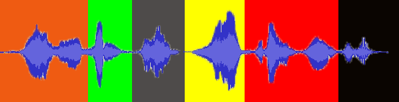
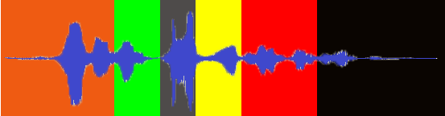
AUDIO IN AMPLITUDE FORM

Slide 7
Sentence recognize | Conclusion Drawn | Question
Ravi will drive me to the cinema tonight | Not somebody else but Ravi. | Who will drive you to the cinema tonight?
Ravi will drive me to the cinema tonight | It’s definite and certain to happen. | Will Ravi drive you to the cinema tonight?
Ravi willdrive me to the cinema tonight | How is it happening? | How will Ravi take me to the cinema tonight?
Ravi will drive me to the cinema tonight | Not somebody else but me. | Who Ravi will drive to the cinema tonight?
Ravi will drive me to the cinema tonight | Not from or back but to. | Where Ravi will drive me tonight?
Ravi will drive me to the cinema tonight | Where? | Where Ravi will drive me tonight?
Ravi will drive me to the cinema tonight | When? | When Ravi will drive me to the cinema?

Slide 8
Algorithm
Highest Peaks
Discrete Average
Moving Average
Area Covered
Time Constraints‘ of words
A number of top picks.

Slide 9
Algorithm
Peaks<Intensity, Duration>= Words Sentence, push (Intensity, Duration) from
Words Start Duration to End Duration.
Top<Intensity, Duration>= Pick top 100 in Peaks on basis of Intensity.
Total Intensity Sum of word =
If (top<Duration> (Word Start to Word End Duration))
Total Intensity sum =top<Intensity>
Score of word =Total Intensity Sum/ (Word End Duration- Word Start Duration)

Slide 10
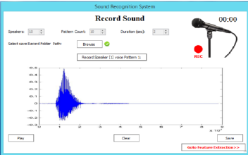
GUI
It will consists of a basic GUI.

Slide 11
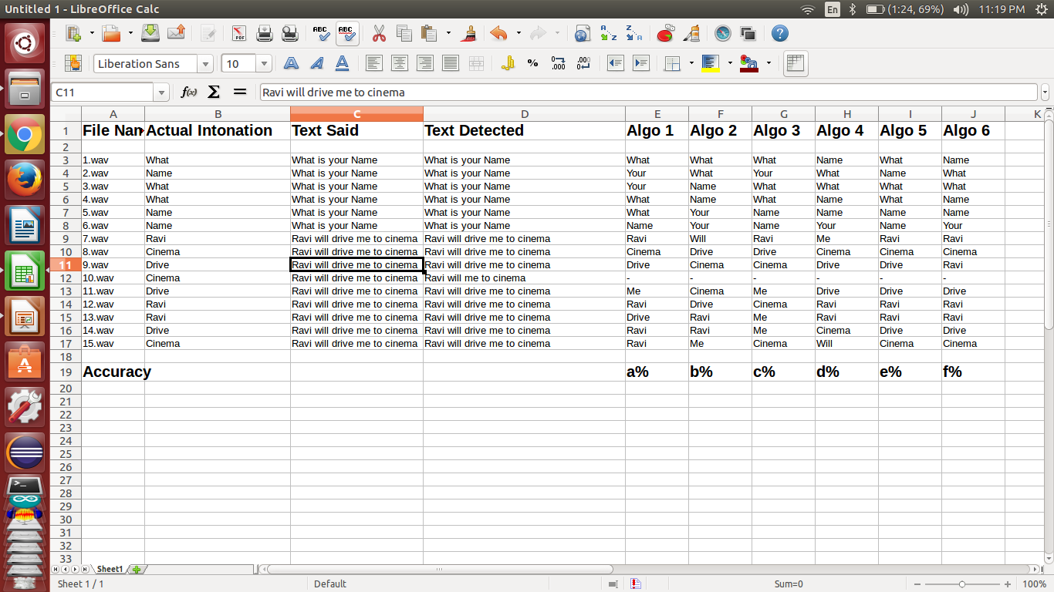
Output

Slide 12
Output
It helps to detect any kind of audio file effectively.
It also helps to correctly detect the stressed part in the sentence of audio file.

Slide 13
USAGE
In Field of Robotics.
Machine Learning
Telecommunication for Improving English
Sarcasm Detection

Slide 14
References
Automatic sentence stress feedback for non-native English learners.
Wikipedia .
Toby Model.

Slide 15
Conclusion
The above algorithm will help to identify and detect stress and improve vocabulary. And the APIs can be used by many different telecommunications companies to improve their workers vocabulary.

